Slide 1


SE113
Lecture 1
Instructor:
Nusrat jahan
Lecturer, SWE, DIU.

Slide 2
Course Materials
Main Text
“Software Engineering”; by Ian Sommerville.
Reference
“Software Engineering, A practitioner’s approach”; by Roger S. Pressman.
Any appropriate material from Internet

Slide 3
Marks Distribution
Assignments 5%
Class Attendance 7%
Presentation 8%
Quiz/ Class Test 15%
Mid Term 25%
Semester Final 40%
Total 100%

Slide 4
What is Software
Software is the set of instructions that tells a computer what to do.
Software is not just a computer program but also all associated documentation and configuration data/files which is needed to make these programs operate correctly.

Slide 5
Software Applications
System Software
Real-time Software
Business Software
Engineering Software
Embedded Software
Personal computer Software
Web-based Software
Artificial Intelligence Software

Slide 6

Software

Slide 7
Software Engineering
Software engineering is an engineering discipline that is concerned with all aspects of software production from the early stages of system specification through to maintaining the system after it has gone into use.

Slide 8
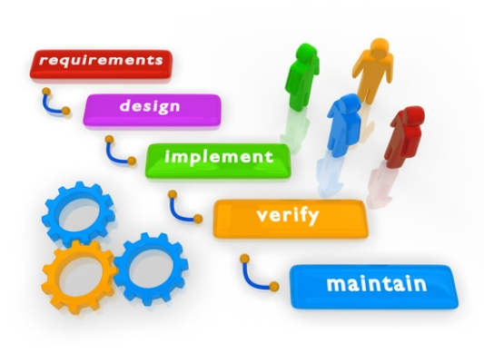
Software Engineering

Slide 9
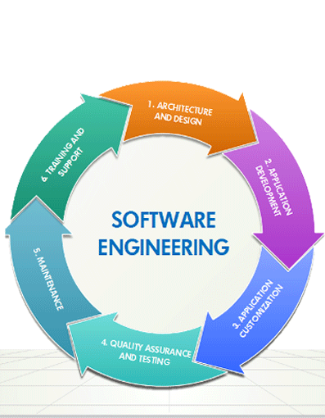
Software Engineering

Slide 10
Software Engineers
Software engineers should adopt a systematic and organised approach to their work and use appropriate tools and techniques depending on the problem to be solved, the development constraints and the resources available.

Slide 11
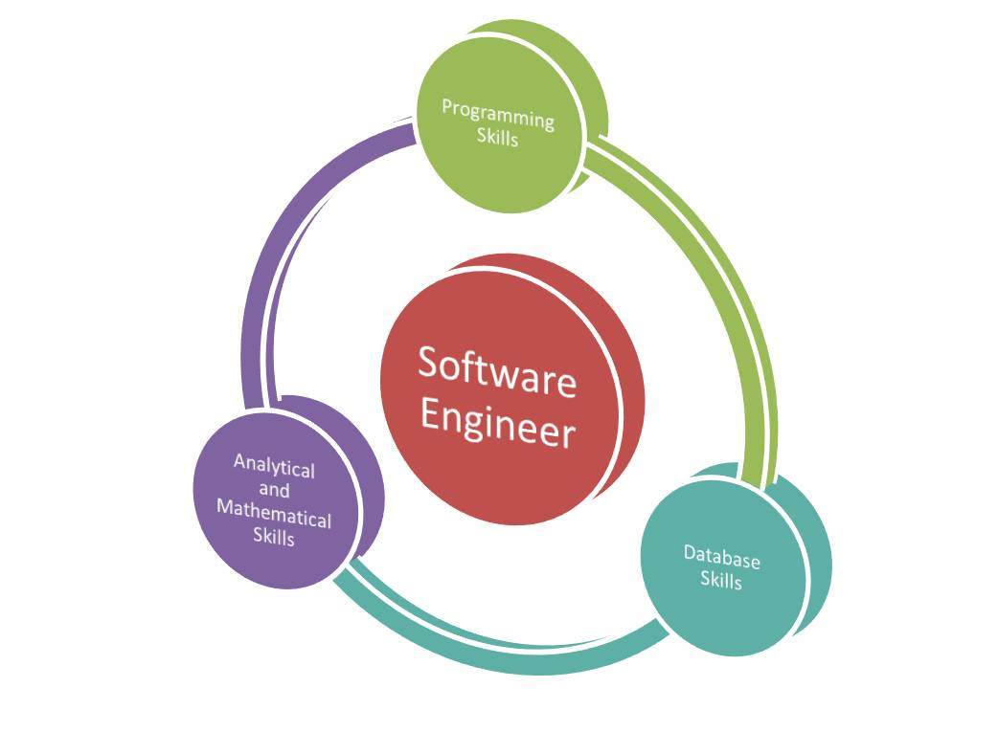
Software Engineer

Slide 12
Thanks

